Slide 1
PL/SQL: Procedures and Functions
School of Built Environment, Engineering and Computing
Sanela Lazarevski (Module Leader)

Slide 2

This sessions will cover
PL/SQL revision
Procedures and Functions
Tutorial this week
Phase Test next week

Slide 3
PL/SQL background
Databases Module
used Oracle’s nonprocedural language SQL
SQL (DDL and DML)
powerful
developers tool
command line driven
SQL is a great query language, but it has its limitations
not user friendly, limited control
Notes:
And its various statements to interface with the oracle server.

Slide 4
Named Program Units
PL/SQL blocks executed thus far have been anonymous blocks
Now we will assign a name to the block and save it in the database as a stored program unit
This makes program units reusable

Slide 5
Types of Program Units
Program Unit Type
Description
Stored Procedures and Functions
Performs a task such as calculation of shipping cost. Can receive input values and return values to the calling program. Called explicitly from a program. Stored in the Oracle database system.
Application Procedures and Functions*
Same as Stored Procedures and Functions except these are saved in an Oracle application or library on the client-side.
Package
A module used to group together related procedures and functions. Called explicitly from a program. Stored on the server side.
Database Trigger
Performs a task automatically when a DML action occurs on the table with which it is associated. Stored in the Oracle database.
Application Trigger*
Performs a task automatically when a particular application event occurs such as the user clicking a button on the screen. Stored in an Oracle application.

Slide 6
Parameters – Make Program Units Reusable
Mechanisms used to send values in and out of program units
MODE
DESCRIPTION
IN
Default if no mode is indicated. Passes a value from the application environment into the procedure or function. This value is considered a constant, as it cannot be changed within the procedure.
OUT
Passes a value out of the procedure to the application environment. If values are calculated or retrieved from the database within the procedure, OUT parameters are used to return these values to the calling environment.
OUT parameters are not typically used in functions.
IN OUT
Allows a value to be passed in and out using the same parameter. The values sent out can be different than the value sent in.
Notes:
Mixing OUT and RETURN values can lead to confusion
It prohibits the function from being used in SQL

Slide 7
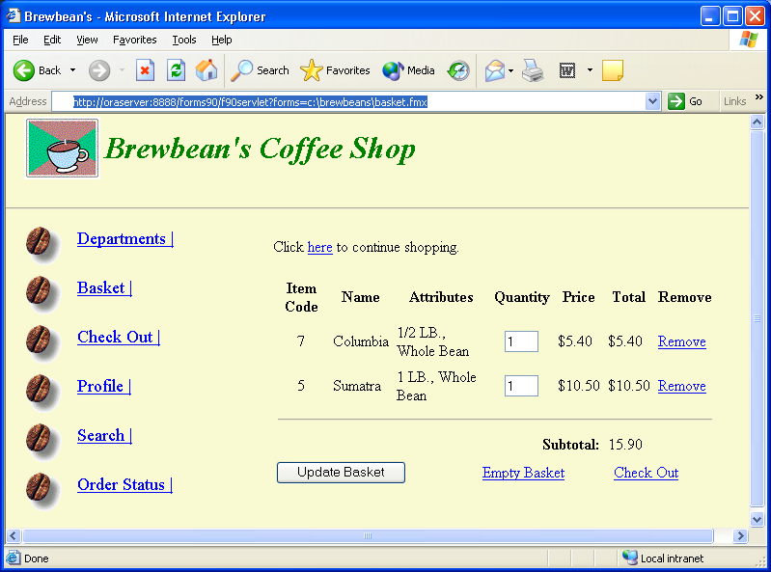
Brewbean’s Challenge
Develop programming modules for specific tasks such as calculating
taxes or updating inventory

Slide 8
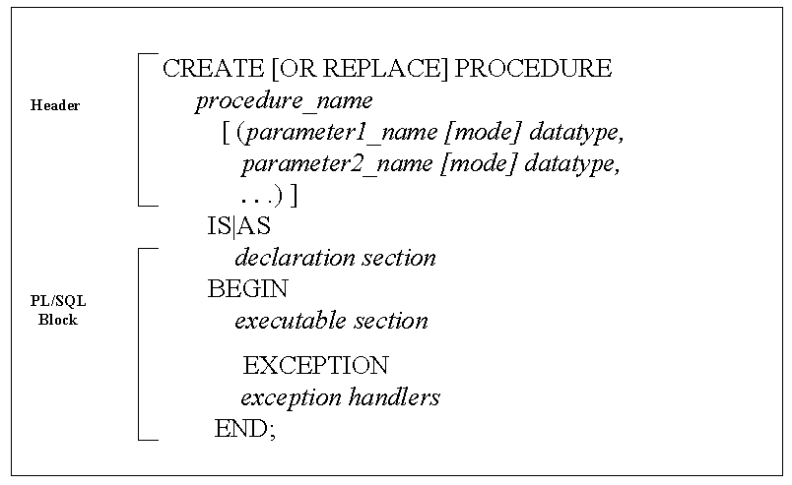
Create Procedure Statement Syntax

Slide 9
Create Procedure Execution
Procedure to determine shipping cost
CREATE OR REPLACE PROCEDURE ship_cost_sp
(p_qty IN NUMBER,
p_ship OUT NUMBER)
IS
BEGIN
IF p_qty > 10 THEN
p_ship := 11.00;
ELSIF p_qty > 5 THEN
p_ship := 8.00;
ELSE
p_ship := 5.00;
END IF;
END;
/
Forward slash on last
line to execute

Slide 10
Execute the Procedure
declare
p_ship NUMBER (6,2);
begin
ship_cost_sp (2, p_ship);
DBMS_OUTPUT.PUT_LINE('Shipping costs is: ' || p_ship);
end;
Value for p_qty
Calling procedure
Parameter that sends OUT value
Note: Parameter arguments are passed positionally

Slide 11
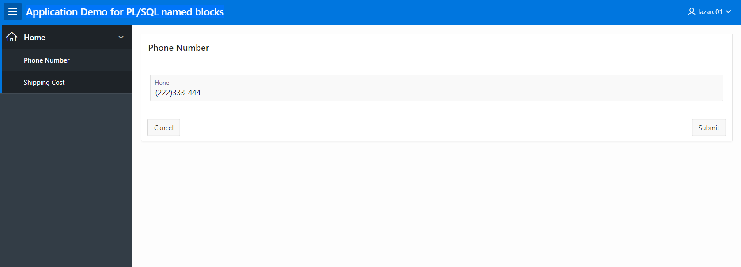
How would this code apply

Slide 12
IN OUT mode
Send value in and out via the same parameter
CREATE OR REPLACE PROCEDURE phone_fmt_sp
(p_phone IN OUT VARCHAR2)
IS
BEGIN
p_phone := '(' || SUBSTR(p_phone,1,3) || ')' ||
SUBSTR(p_phone,4,3) || '-' ||
SUBSTR(p_phone,7,4);
END;
/
DECLARE g_phone VARCHAR2(13);
BEGIN
???? :='111222333';
???? (g_phone);
DBMS_OUTPUT.PUT_LINE(????);
END;
Notes:
DECLARE g_phone VARCHAR2(13);
BEGIN
g_phone :='111222333';
phone_fmt_sp(g_phone);
DBMS_OUTPUT.PUT_LINE(g_phone);
END;

Slide 13

How would this code apply

Slide 14
Debugging
Use DBMS_OUTPUT.PUT_LINE statements to display messages from execution
Place display messages throughout the block to determine processing flow and variable values

Slide 15
DBMS_OUTPUT.PUT_LINE
DECLARE
Emp_number INTEGER := 9999;
Emp_name VARCHAR2(10); BEGIN
SELECT Ename INTO Emp_name FROM Emp
WHERE Empno = Emp_number; -- no such number
DBMS_OUTPUT.PUT_LINE('Employee name is ' || Emp_name);
EXCEPTION
WHEN NO_DATA_FOUND THEN
DBMS_OUTPUT.PUT_LINE('No such employee: ' || Emp_number);
END;

Slide 16
Transaction Scope
The scope refers to the group of DML statements that are affected by a particular transaction control statement
By default, a session has a single DML queue and a transaction control statement would affect all DML in the queue regardless of which program unit initiated the statement
DML statements of a program unit can be treated separately or as an autonomous transaction

Slide 17
Autonomous Transaction
CREATE OR REPLACE PROCEDURE tc_test_sp1 IS
BEGIN
INSERT INTO bb_test1
VALUES (2);
END;
Indicates contained
DML statements are
autonomous
-- to run procedure
BEGIN
tc_test_sp1;
END;

Slide 18
Procedure adjust_salary
CREATE OR REPLACE PROCEDURE adjust_salary(
in_employee_id IN emp.empno%TYPE,
in_percent IN NUMBER
) IS
BEGIN
-- update employee's salary
UPDATE emp
SET sal= sal + sal * in_percent / 100
WHERE empno= in_employee_id;
END;
Write a code to call procedure adjust_salary in order to increase salary for employee 7566 with 20%

Slide 19
Introduction to Functions
A function is similar to a procedure in that it can accomplish a task and retrieve/return values
A function is part of an expression, not an entire statement such as a procedure
Can be used in both PL/SQL and SQL statements
Same as Oracle-supplied functions (ROUND, TO_CHAR)
Contains a RETURN statement

Slide 20
Example of Oracle-Supplied Function
SELECT idProduct, price, ROUND(price, 0)
FROM bb_product
WHERE idProduct < 4;

Slide 21
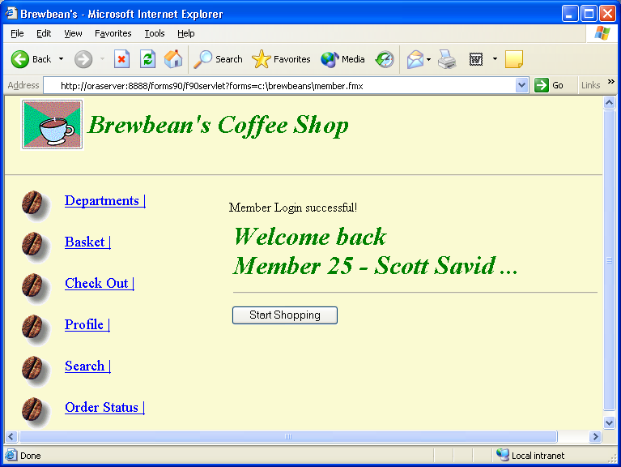
Brewbean’s Challenge
Need program module to check a user login

Slide 22
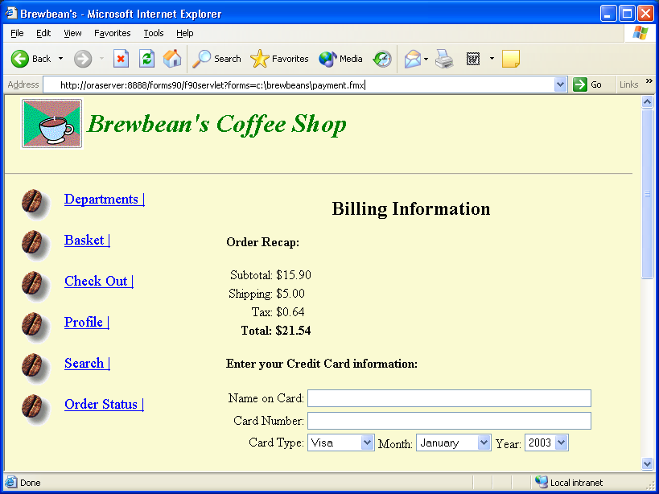
Brewbean’s Challenge (continued)
Need program module to calculate shipping cost based on the number
of items in the basket

Slide 23
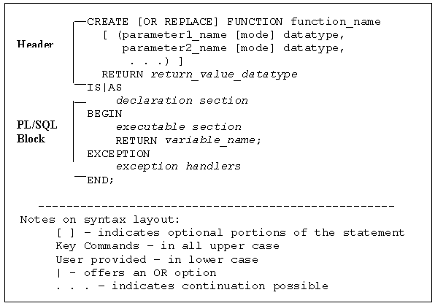
Function Create Statement

Slide 24
Brewbean’s Member Display
CREATE OR REPLACE FUNCTION memfmt1_sf
(p_id IN NUMBER,
p_first IN VARCHAR2,
p_last IN VARCHAR2)
RETURN VARCHAR2
IS
lv_mem_txt VARCHAR2(35);
BEGIN
lv_mem_txt := 'Member '||p_id||' - '||p_first||' '||p_last;
RETURN lv_mem_txt;
END;
Notes:
-- test variable
Declare
lv_mem_txt varchar2(50);
lv_id number (5) :=25;
lv_first VARCHAR2 (20) := 'Scott';
lv_last VARCHAR2 (20) := 'Savid';
Begin
lv_mem_txt := memfmt1_sf (lv_id, lv_first, lv_last);
Dbms_output.put_line(lv_mem_txt);
End;
/

Slide 25
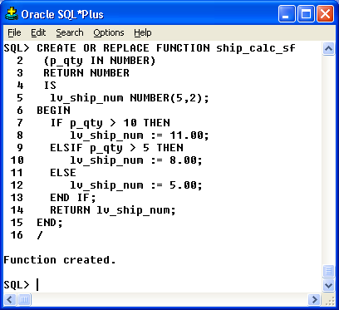
Function Example
Shipping cost
Notes:
Declare
lv_cust_num number (5,2);
Begin
lv_cust_num := ship_calc_sf (12);
Dbms_output.put_line(lv_cost_num);
End;
/

Slide 26
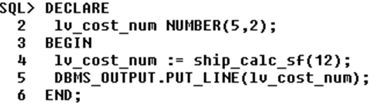
Invoking a Function from a Block
An assignment statement is used – a function RETURNS a value!
Calling FUNCTION
Notes:
Declare
lv_cust_num number (5,2);
Begin
lv_cust_num := ship_calc_sf (12);
Dbms_output.put_line(lv_cost_num);
End;

Slide 27
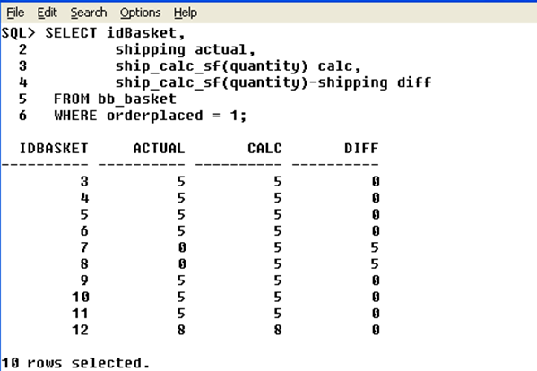
Use Function in SQL
Notes:
desc bb_basket
Select idbasket, shipping actual, ship_calc_sf (quantity) calc, ship_calc_sf (quantity) - shipping diff
from bb_basket
where orderplaced = 1;

Slide 28
Function total purchase
CREATE OR REPLACE FUNCTION tot_purch_sf
(p_id NUMBER)
RETURN NUMBER
IS
lv_tot_num NUMBER(8,2);
BEGIN
SELECT SUM(total)
INTO lv_tot_num
FROM bb_basket
WHERE idShopper = p_id;
RETURN lv_tot_num;
END;
/
Complete this SQL code to call this function.
SELECT idShopper,???? (idShopper)
FROM bb_shopper;
Notes:
--Call the function WITHIN SQL:
SELECT idShopper,Tot_purch_sf(idShopper)
FROM bb_shopper;

Slide 29
Another example
CREATE OR REPLACE FUNCTION ck_sale_sf
(p_id IN NUMBER,
p_date IN DATE)
RETURN VARCHAR2
IS
lv_start_dat DATE;
lv_end_dat DATE;
lv_msg_txt VARCHAR2(15);
BEGIN
SELECT salestart, saleend
INTO lv_start_dat, lv_end_dat
FROM bb_product
WHERE idProduct = p_id;
IF p_date BETWEEN lv_start_dat AND lv_end_dat THEN
lv_msg_txt := 'ON SALE!';
ELSE
lv_msg_txt := 'Great Deal!';
END IF;
RETURN lv_msg_txt;
END;
What is the code to test this function?

Slide 30
Function emp_count
CREATE OR REPLACE FUNCTION emp_count
RETURN number
IS
emp_count NUMBER;
BEGIN
SELECT count(*)
INTO emp_count
FROM emp;
RETURN emp_count;
END;
-- call function from SQL statement
SELECT emp_count()
FROM emp;
Notes:
select emp_count()
from emp

Slide 31
Function Summary
Functions can be used in PL/SQL and SQL statements
A function is part of an expression
Functions include parameters and must return a value
OUT parameter rarely used
Pass parameter values by value or reference

Slide 32
Procedure Summary
Named program unit assigns a name to a program unit so it can be reused
Parameters are used to pass values in and out of program units
Stored program units are saved in the database
DML statement used in procedure
Parameter modes include: IN, OUT, and IN OUT
Use DBMS_OUTPUT.PUT_LINE statement to debug
Autonomous transactions must be explicitly created

Slide 33
READING
Connolly/Begg (4th ed) 8.2.4
Earp/Bagui Ch. 12, 13
Shah Part 3 (Ch 10,12)
Morrison/Morrison Ch.4, 9 – selected bits
Casteel, J (2003). Oracle 9i Developer: PL/SQL Programming

Slide 34
Any questions?

